Slide 1
Welcome!

Slide 2
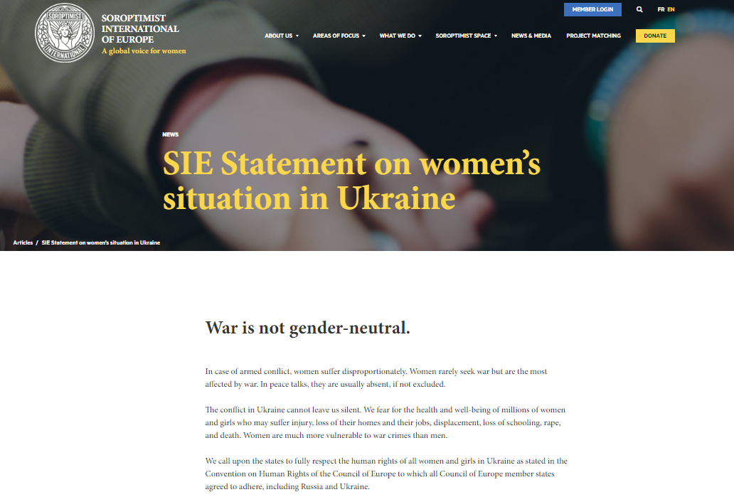
Share SIE statement in your country
Our statement is spread to many organisations, one example is European Women Lobby – it is on their website.
https://www.soroptimisteurope.org/sie-statement-womens-situation-ukraine/ It is placed under News & Media-section

Slide 3
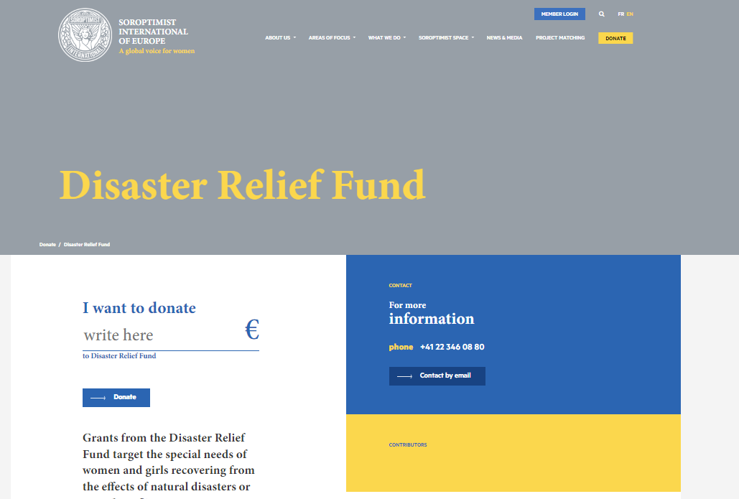
Two possibilites to support:
Project Matching
Disaster Relief Fund

Slide 4
SIE Project Matching
Our tool and platform to support each others project.
Via a form we collect information.
Financial or other support directly to the project owner and supporting club/Union.

Slide 5
Now on the website:
Three projects
https://soroptimist-projects.org/explore-projects/
One more project is on the way: SI Stefan Voda, Moldova

Slide 6
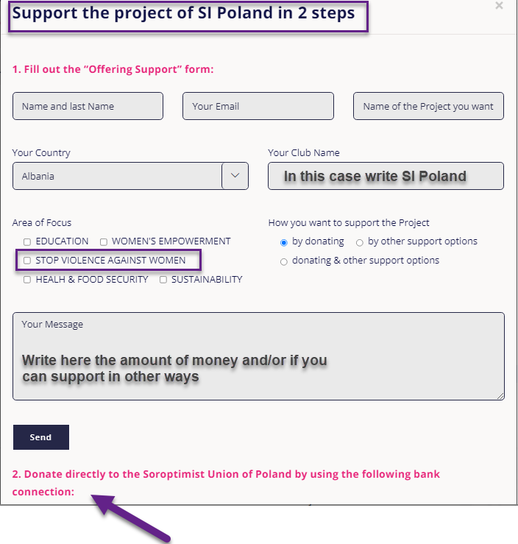
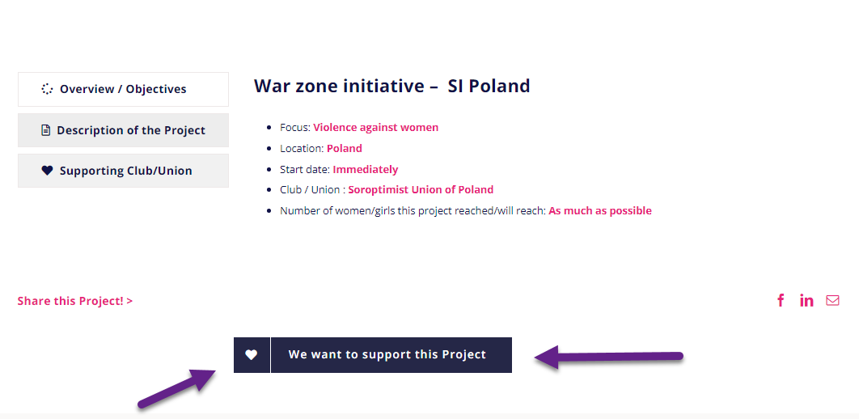
How does it look like?
Two steps: fill in the form and donate directly. Information with bank details is on the same page.

Slide 7
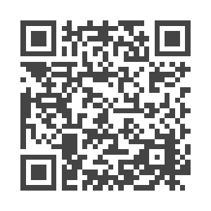
Donate to Disaster Relief Fund
Donated money will go to Soroptimist projects in the federation.
Easy to donate via the webpage via banktransfer or via PayPal (via PayPal directly with credit card)
https://www.soroptimisteurope.org/donate/disaster-relief-fund/

Slide 8
What initiatives have you done so far?
Are you in contact with embassies?
Have you sent the statement to your authorities and other NGO’s?
Are you setting up a list among your members for future accommodations?
If you have projects in nearby countries, please reminder to use the Project Matching Tool.
If you want to take part of donated money from the Disaster Relief Fund, there is an application to fill in. Please reach out to siehq@soroptimisteurope.org

Slide 9
Please remember
Highlight the donations to Distaster Relief Fund

